Slide 1

Brian Heits
Associate Lead Software Engineer – Edge Professional Services
April 27th, 2022
Notes:
© Cerner 2016

Slide 2
FHIR Deep Dive

Slide 3
Getting Started: HL7 Community

Slide 4
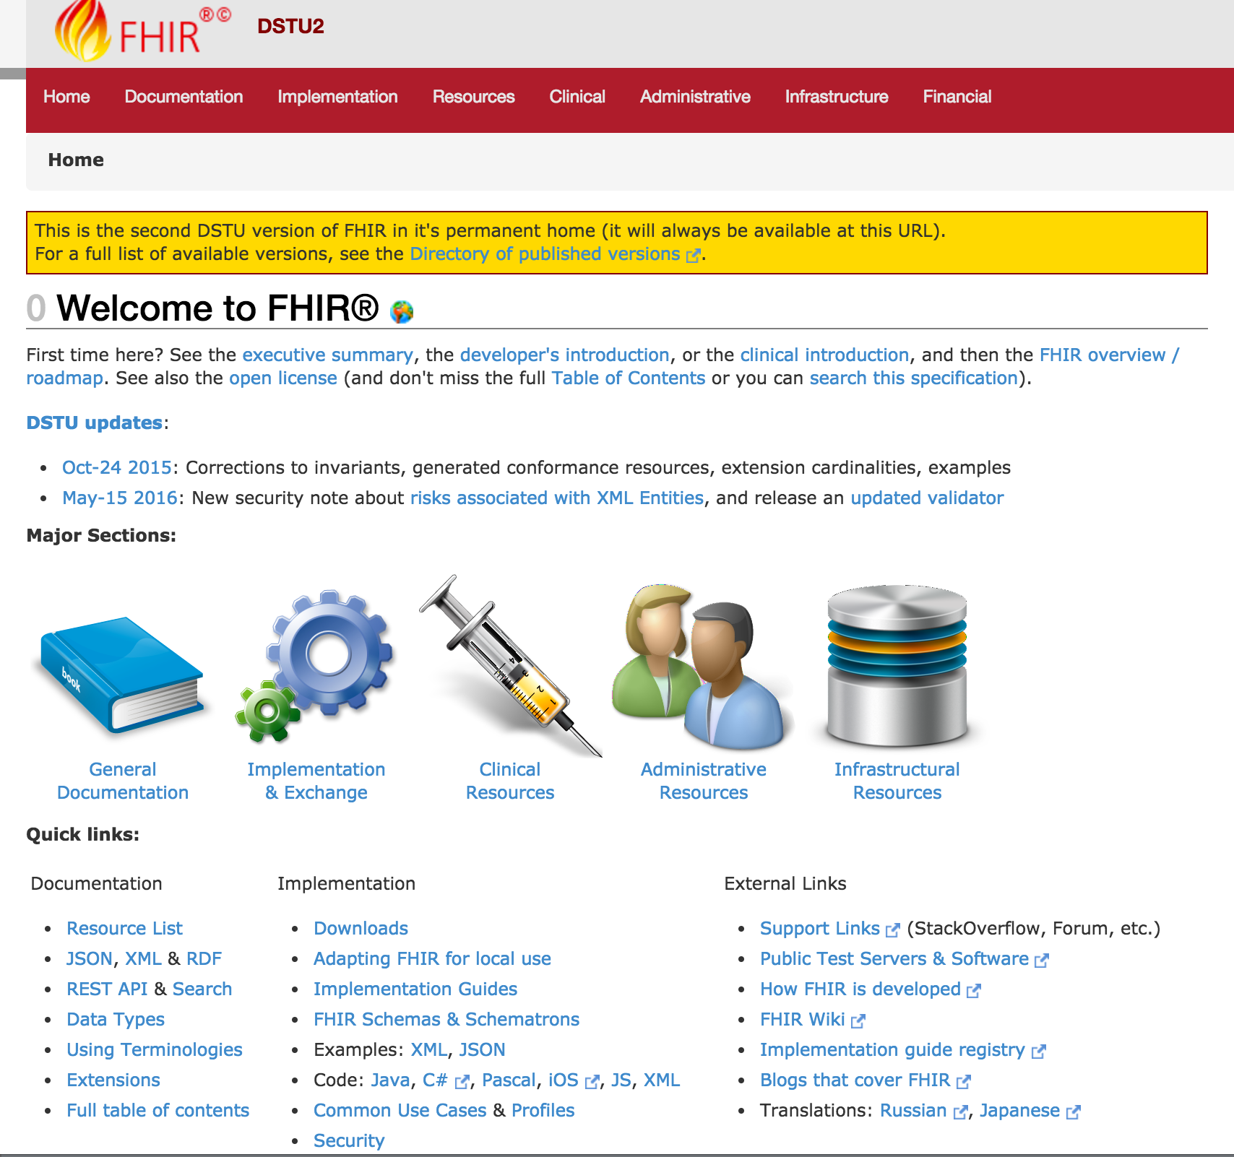






Versioning
Introductions
Support
Cheatsheets & Info
Updates
http://hl7.org/fhir/dstu2/index.html

Slide 5
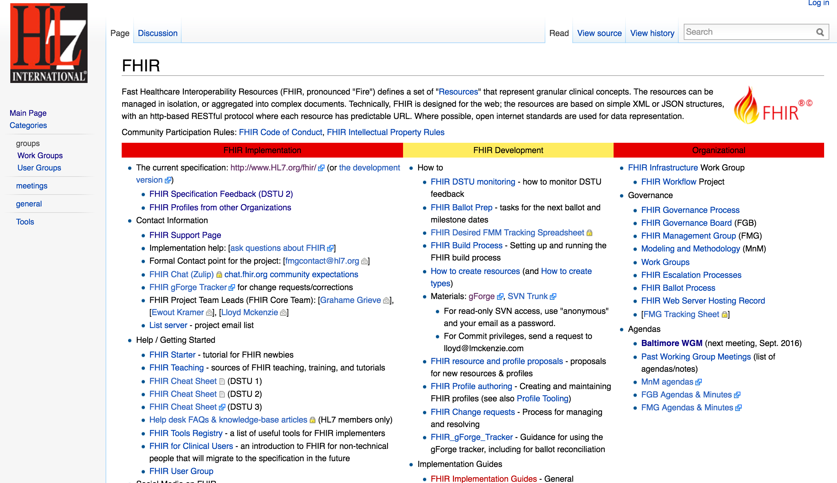
Getting Started
http://wiki.hl7.org/index.php?title=FHIR

Slide 6



Note: HAPI is the recommended Java Reference implementation
http://hapifhir.io/index.html
Resources
Spec Details
Reference Libraries

Slide 7
Specification Versioning

Slide 8
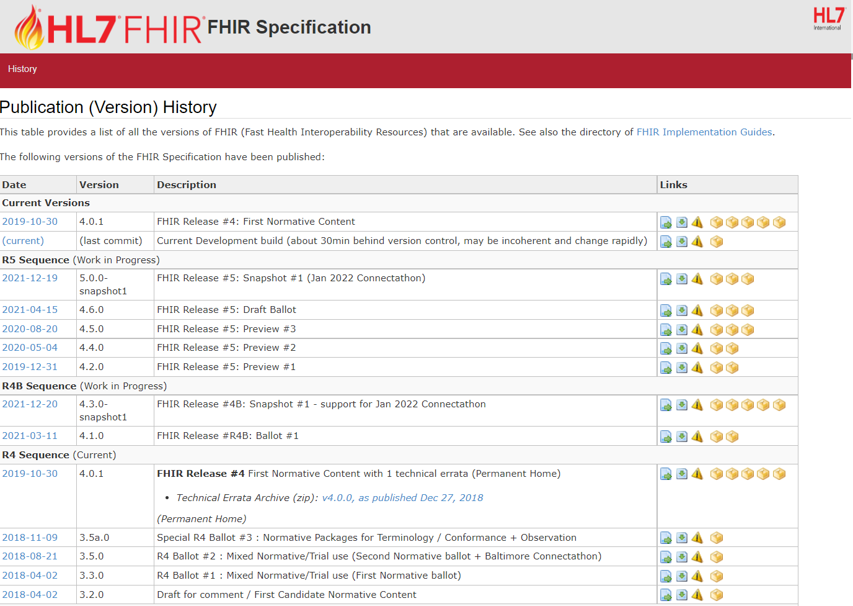
Current: R4 Sequence
AKA: 4.0.1
http://hl7.org/fhir/directory.html

Slide 9

Which Version?
Multiple Available
Deprecate Oldest
Time to Uplift Applications

Slide 10
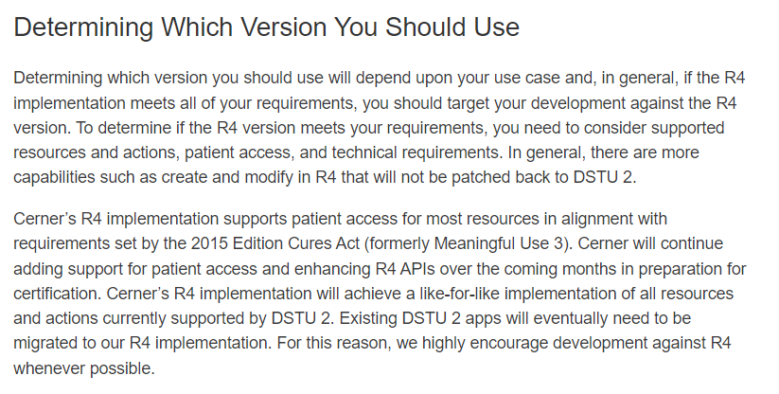
Latest Millennium Production: R4/4.0.1
https://fhir.cerner.com/millennium/overview/

Slide 11
Data Types

Slide 12
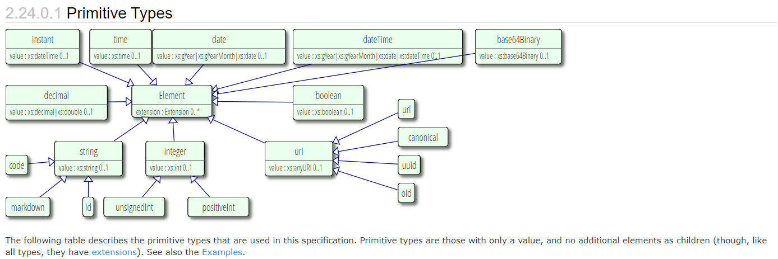
Primitive Types
http://hl7.org/fhir/datatypes.html#primitive

Slide 13
Surprises
Decimal: 1.01, 1.010
Instant vs DateTime
DateTime vs Date vs Time
Notes:
Decimals, precision matters (e.g.: use big decimal)
Instant is for machines, DateTime is for humans. Instant MUST have seconds and zone.
DateTime is year, year/month, year/month/day, year/month/day/time (must have zone if there’s a time). Seconds are required (XML definition/schema), but can be ignored or zero.
Date is year, year/month, year/month/day
Time is zone-less, dateless (see you at 8:00 AM every day)

Slide 14
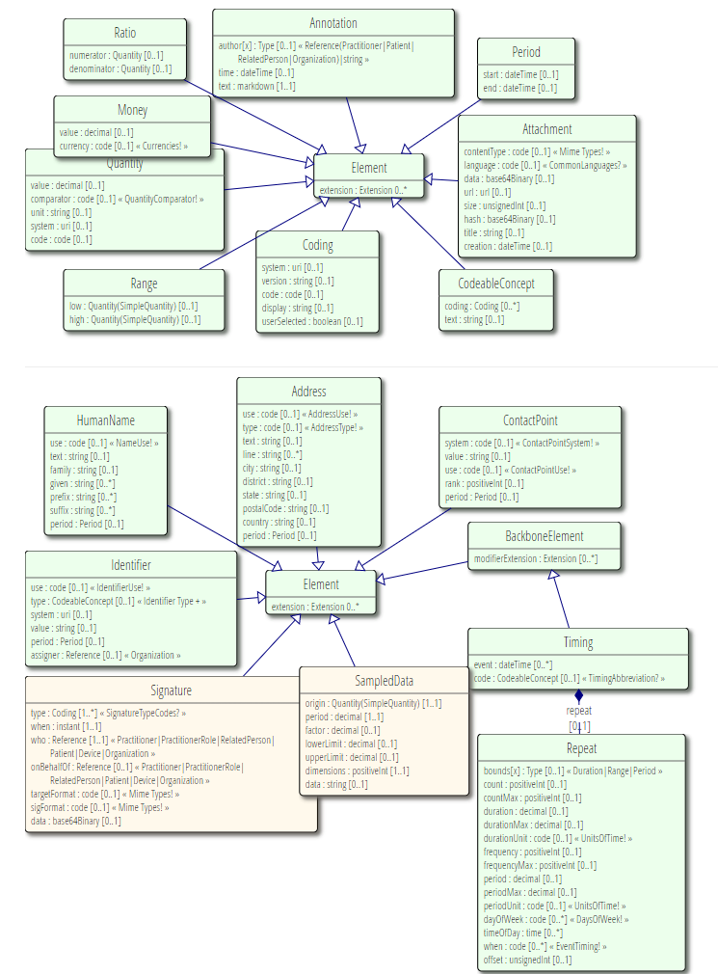
Complex Types
http://hl7.org/fhir/datatypes.html#complex

Slide 15
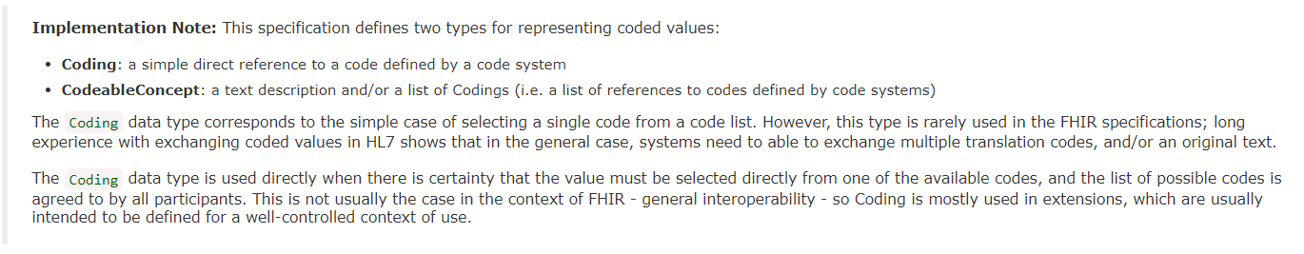
Code Systems
http://hl7.org/fhir/datatypes.html#codesystem
Notes:
Code: codified value (usually from a set of values) to represent a concept.
Coding: Code + meta data (e.g., system, version)
CodeableConcept allows you to choose a list of codes, e.g.: multiple terminologies
CodeableConcept references Coding, Coding references a Code.
Code: m, f, unk
Coding: m, + system
CodeableConcept: Relationship type for patient contacts, Observation type (e.g.: height/weight, Loinc, SNOMED)

Slide 16
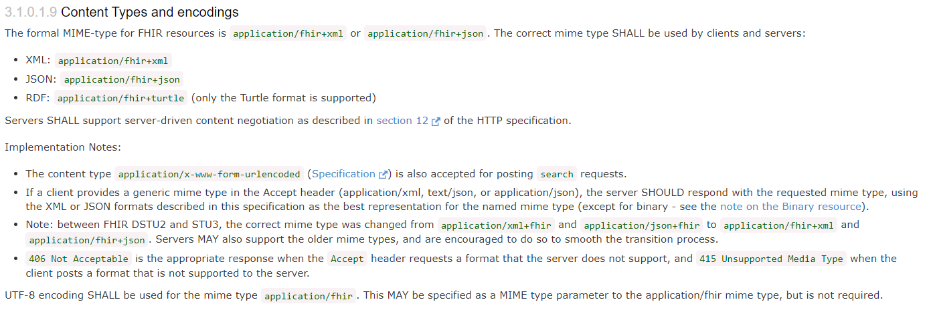
Formats
JSON, XML, or RDF
Via Accept or Content-Type headers
Via _format parameter
https://hl7.org/fhir/http.html#mime-type

Slide 17
Resources

Slide 18
Resources
Patient, Condition, MedicationOrder…
All resources have metadata
All resources have narrative
Structured data items
[base]/[Resource] (case sensitive)
[base]/Patient
http://hl7.org/fhir/dstu2/resource.html

Slide 19
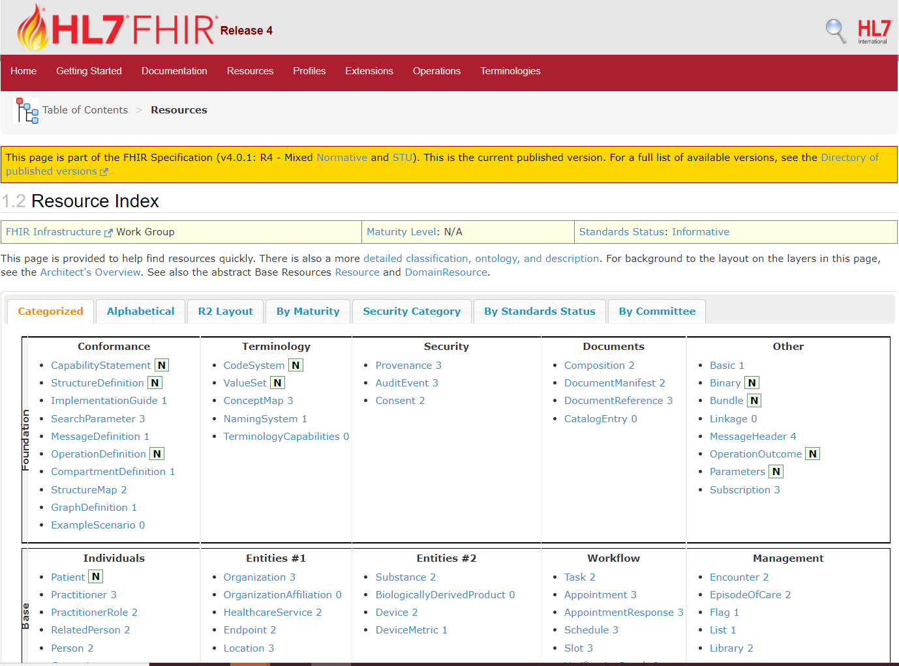
http://hl7.org/fhir/resourcelist.html
Notes:
That number to the side…?

Slide 20
Maturity Levels
Risk for change
Lower number, highest risk
0-5 or (N)ormative
https://hl7.org/fhir/versions.html#maturity
Notes:
If you are adverse to change, choose 4+
… which doesn’t exist in DSTU 2

Slide 21
Terminology Bindings

Slide 22
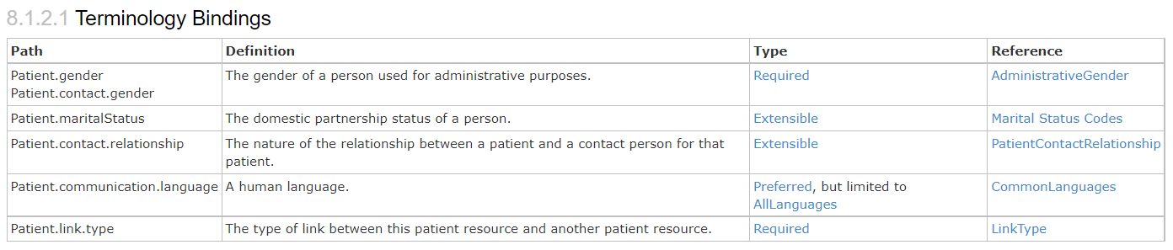
Terminology Bindings
https://hl7.org/fhir/patient.html#tx

Slide 23
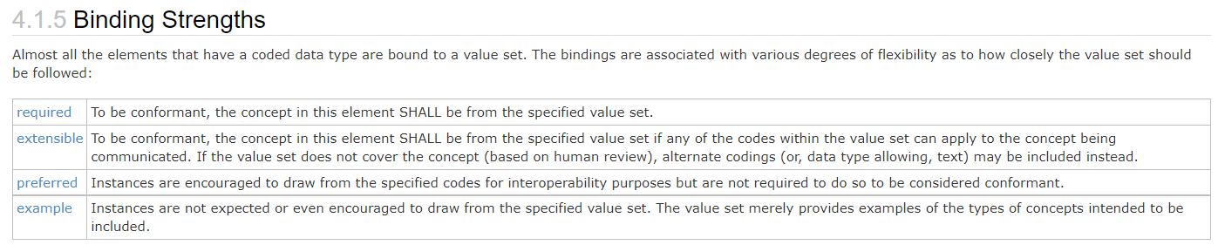
Type/Binding Strength
https://hl7.org/fhir/terminologies.html#strength
Notes:
Required: for codeableConcept, you can’t just send “text”

Slide 24
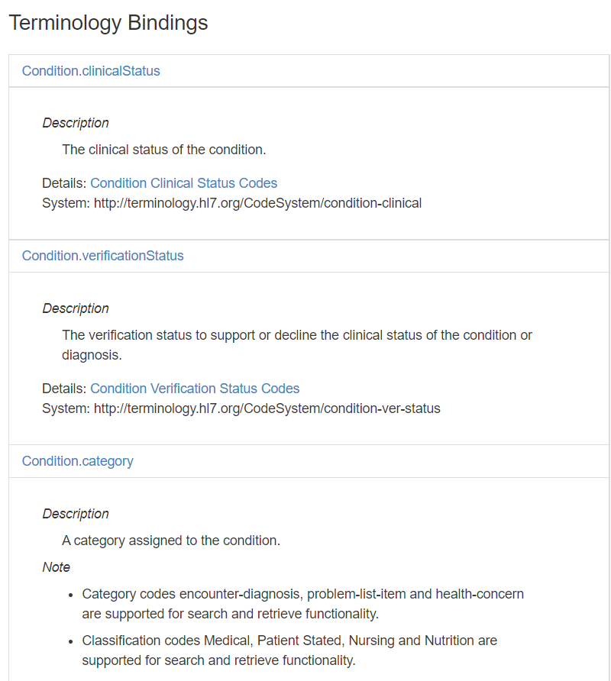
https://fhir.cerner.com/millennium/r4/clinical/summary/condition/#terminology-bindings
Notes:
If a binding isn’t “required” by core spec, we’ll call out what our binding strength is in documentation

Slide 25
Narrative

Slide 26
“Any resource that is a domain resource (almost all types of resource) may include a human-readable narrative that contains a summary of the resource, and may be used to represent the content of the resource to a human. If narrative is present, it SHALL reflect all content needed for a human to understand the essential clinical and business information otherwise encoded within the resource. Resource definitions may define what content should be represented in the narrative to ensure clinical safety.”
https://hl7.org/fhir/narrative.html#Narrative
Notes:
It is often the fall back if a client application doesn’t understand the FHIR resource in question

Slide 27
…”text”: {
"status": "generated",
"div": "<div><table><tbody><tr><td>Name</td><td>Peter James <b>Chalmers</b> (&quot;Jim&quot;)</td></tr><tr><td>Address</td><td>534 Erewhon, Pleasantville, Vic, 3999</td></tr><tr><td>Contacts</td><td>Home: unknown. Work: (03) 5555 6473</td></tr><tr><td>Id</td><td>MRN: 12345 (Acme Healthcare)</td></tr></tbody></table></div>"
}…

Slide 28
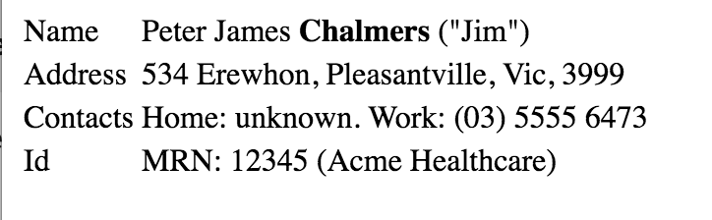

Slide 29
Exercise 1

Slide 30
Exercise 1
Identify the FMM (maturity model) of the Following resources for R4:
Patient
Condition
Observation
Coverage

Slide 31
Exercise 1: Answer
Identify the FMM (maturity model) of the Following resources for R4: https://hl7.org/fhir/resourcelist.html
Patient: N
Condition: 3
Observation: N
Coverage: 2

Slide 32
Exercise 2

Slide 33
Exercise 2
Find out what resources are available in Millennium’s HL7 FHIR R4 implementation that are not in the DSTU2 implementation.

Slide 34
Exercise 2: Answer
PractitionerRole
CareTeam
BodyStructure
OrganizationAffiliation
MolecularSequence
Task
VerificationResult
Linkage
CatalogEntry
AdverseEvent
Optional: MedicationOrder is no longer available in R4 and now split

Slide 35
Exercise 3

Slide 36
Exercise 3
What search parameters does the Millennium R4 implementation of Patient support? Are there any limitations or considerations?

Slide 37
Exercise 3: Answer
Query by: _id
Query by: identifier
Query by a combination of: identifier, birthdate, name, given, family, address-postalcode, phone, or email
There are others (see next slide)
https://fhir.cerner.com/millennium/r4/base/individuals/patient/#parameters

Slide 38
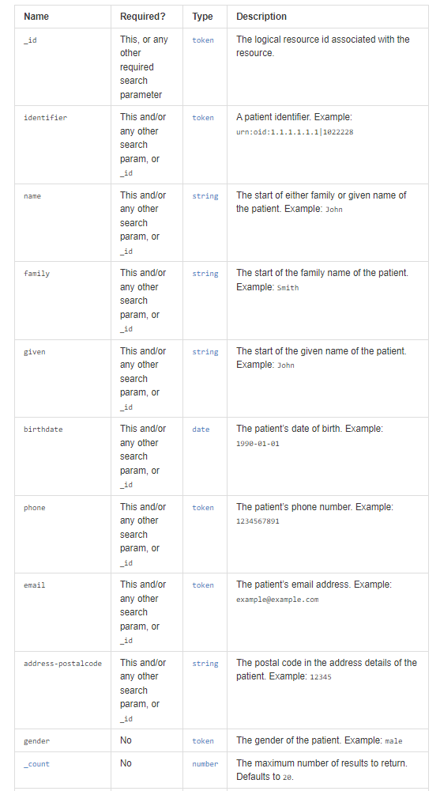

Slide 39
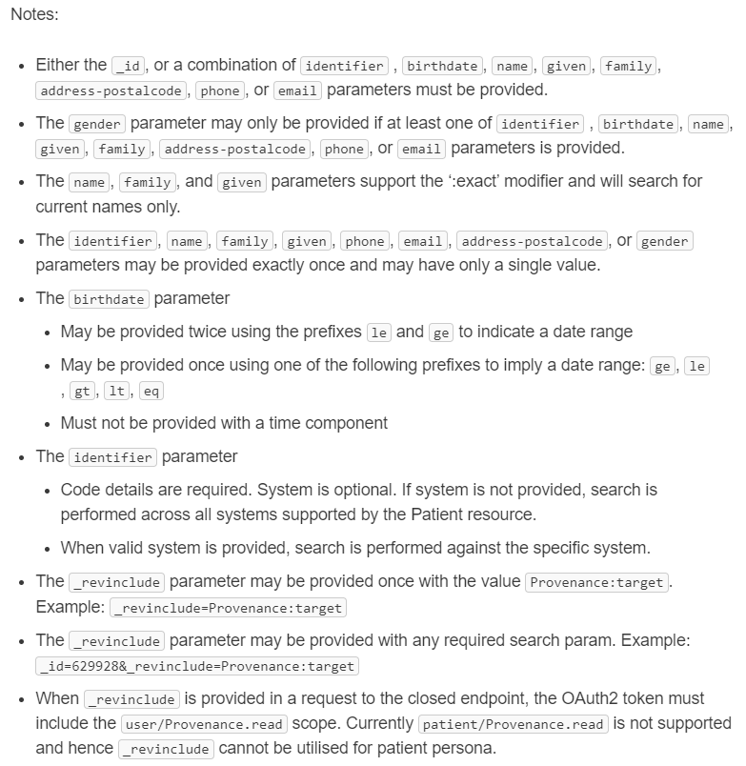

Slide 40
Read

Slide 41
Read
“By ID”
[base]/[Resource]/[id]
[base]/Patient/123ABC
https://hl7.org/fhir/http.html#read

Slide 42
id vs identifier
id: logical identifier, must be unique within the FHIR server and resource
identifier: business identifier or “alias”
SSN
MRN
Military ID
https://hl7.org/fhir/resource.html#id

Slide 43
Search

Slide 44
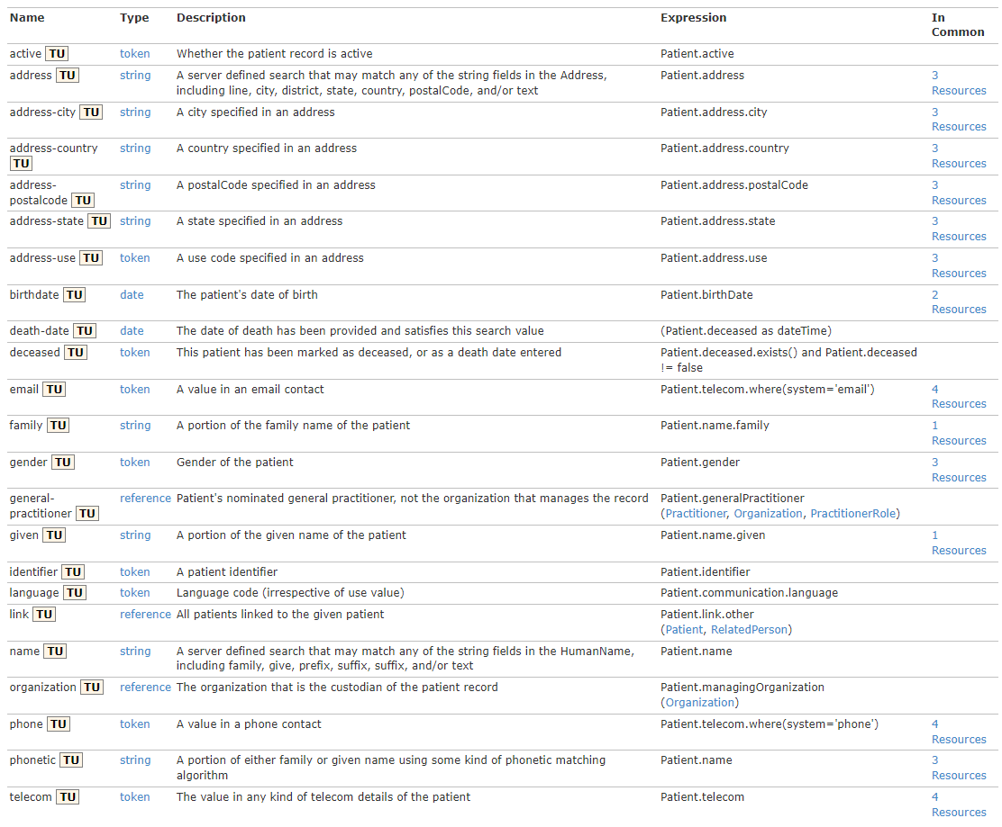
https://hl7.org/fhir/patient.html#search

Slide 45
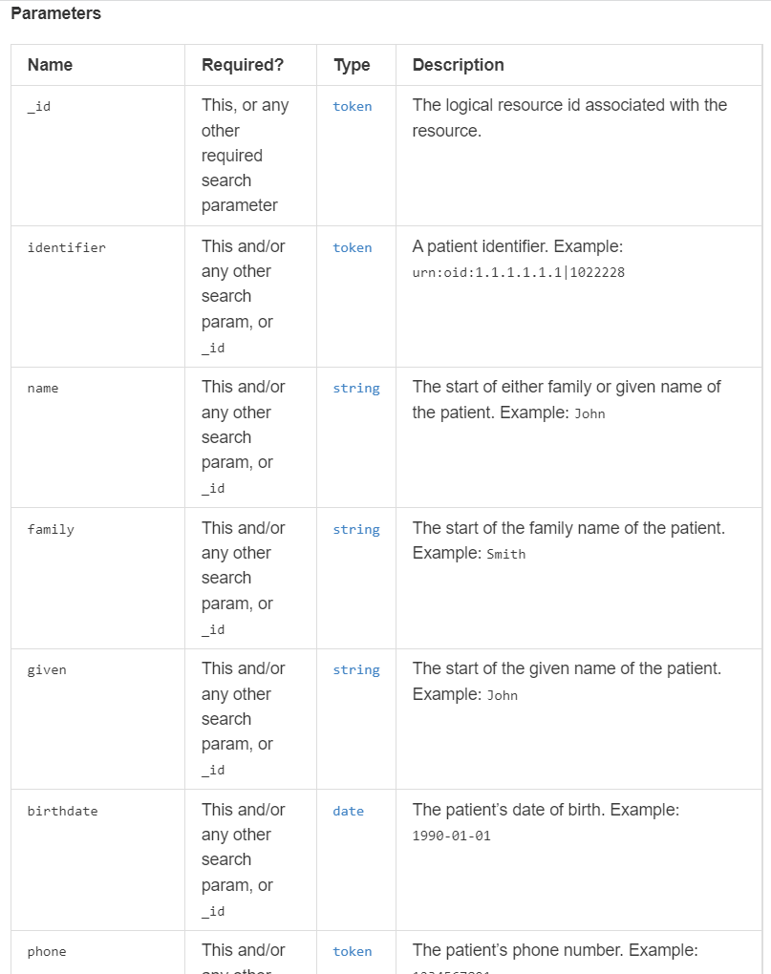
https://fhir.cerner.com/millennium/r4/base/individuals/patient/#parameters

Slide 46
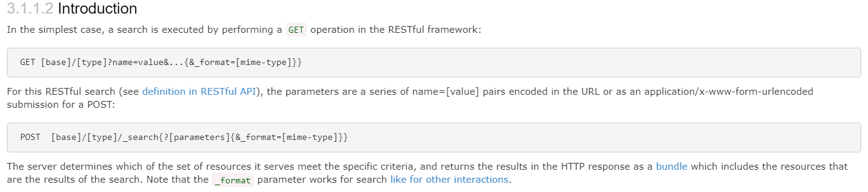
GET [base]/AllergyIntolerance?patient=123
https://hl7.org/fhir/search.html#Introduction
Notes:
This example is searching for all allergies for patient 123

Slide 47
Paging

Slide 48
Paging
Self, First, Previous, Next, Last
Must use link as provided
Changing this has undefined consequences
_count parameter
Less but not more
For interoperability - handle paging
https://hl7.org/fhir/http.html#paging
Notes:
Handle paging in the application, which helps ensure you’re run against most servers. Check for the “next” link to see if there are additional pages.

Slide 49
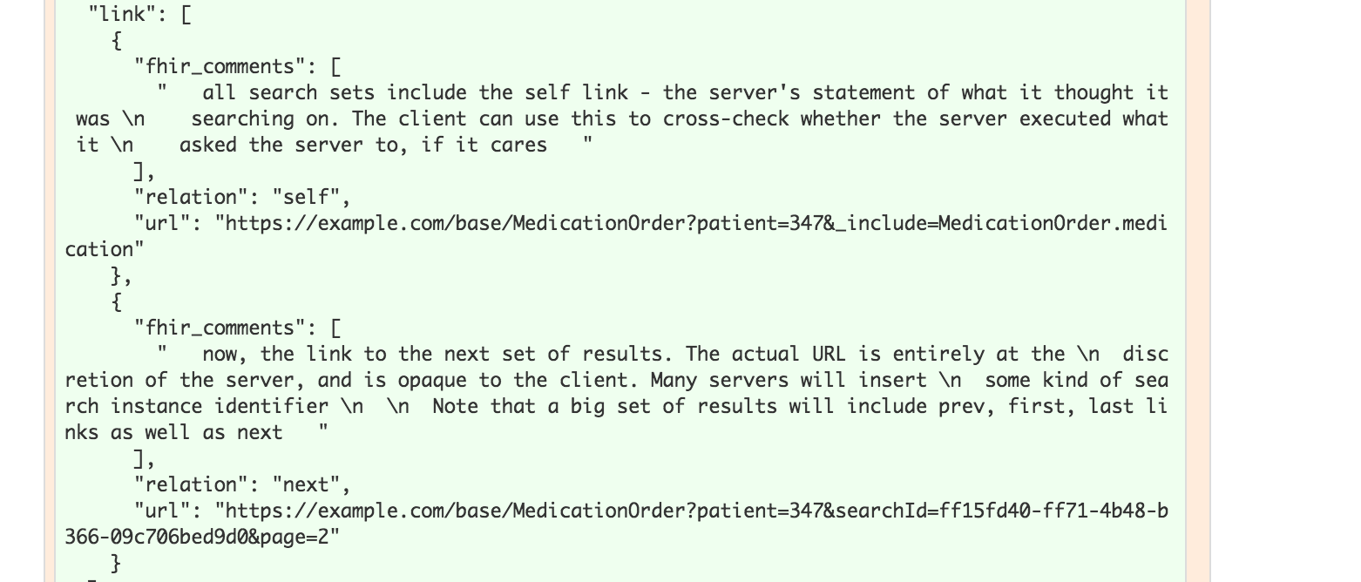
Notes:
The previous link isn’t in this example

Slide 50
Writes

Slide 51
Create
POST [base]/[Resource]
POST [base]/AllergyIntolerance
Body (content-type) must match supported FHIR format
https://hl7.org/fhir/http.html#create

Slide 52
Update
PUT [base]/[Resource]/[id]
PUT [base]/AllergyIntolerance/123
Body (content-type) must match supported FHIR format
https://hl7.org/fhir/http.html#update

Slide 53
Patch
PATCH [base]/[Resource]/[id]
PATCH [base]/AllergyIntolerance/123
Body (content-type) must match supported FHIR format
https://hl7.org/fhir/http.html#patch

Slide 54
Conditional Update
Optimistic Locking via “If-Match”
Example: Version in database: 2a
Version in “If-Match”: 1a - failure
Version in “If-Match”: 2a - success
https://hl7.org/fhir/http.html#transaction

Slide 55
Exercise 4

Slide 56
Exercise 4
Find out the middle name for Patient Test1 Smart (id = 12724070)

Slide 57
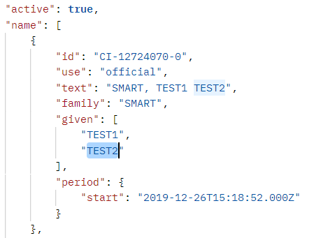
Exercise 4: Answer
Answer: Test2
GET https://fhir-open.cerner.com/r4/ec2458f2-1e24-41c8-b71b-0e701af7583d/Patient/12724070?_format=json
https://hl7.org/fhir/datatypes.html#HumanName (middle is subsequent given name)
Notes:
Note: Patient vs Person. Person represents people “in the real world” for example, it could link to your patient record in many FHIR servers. In CommonWell, most of the core is the “Person” and the records they’re tied to are Patient. We would use Patient here since we’re looking at patient records in an EHR.

Slide 58
Exercise 5

Slide 59
Exercise 5
How many current allergies or intolerances does Sandy Smart (id = 12742399) have?
Current: actual or possible existing allergies or intolerances
Hint: What indicates “current” for this FHIR resource?

Slide 60
Exercise 5: Answer
16
GET https://fhir-open.cerner.com/r4/ec2458f2-1e24-41c8-b71b-0e701af7583d/AllergyIntolerance?clinical-status=active&patient=12742399&_format=json
Notes:
Note: AllergyIntolerance/123 is looking up an Allergy by its id (not a patient id). Similarly, AllergyIntolerance?_id=123 is looking up allergy by id, not by the patient id.

Slide 61
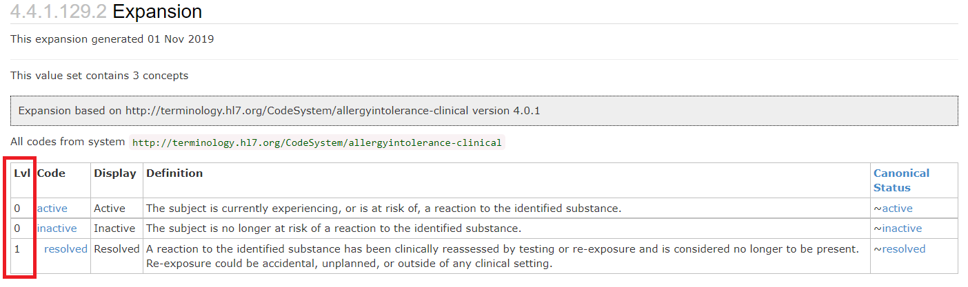
https://hl7.org/fhir/r4/valueset-allergyintolerance-clinical.html#expansion

Slide 62
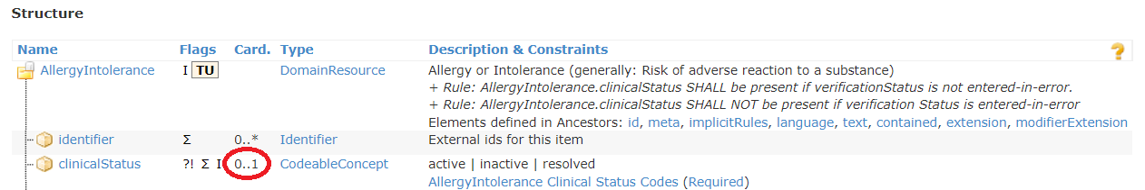
What if it wasn’t mapped/known?
https://hl7.org/fhir/allergyintolerance.html#resource
Notes:
Be aware that querying by a field that isn’t required may mean that values that weren’t mapped or understood by the FHIR server won’t be returned.
In the Allergy case, STU 3 is addressing this issue with allergies by requiring the status and adding an “unknown” that could be used to ensure all possible allergies can be retrieved.

Slide 63
Exercise 6

Slide 64
Exercise 6
How many different medication orders of Sertraline does Test1 Smart (id = 1316024) have?

Slide 65
Exercise 6: Answer
1
GET https://fhir-open.cerner.com/r4/ec2458f2-1e24-41c8-b71b-0e701af7583d/MedicationRequest?patient=12724070&status=active&_format=json
GET https://fhir-open.cerner.com/r4/ec2458f2-1e24-41c8-b71b-0e701af7583d/MedicationRequest?patient=12724070&status=active&-pageContext=T3BlblBsYXRmb3JtRmhpckNvbnRleHQ9dHJ1ZSZwYWdlQ29udGV4dD0zNjU5NTA5XzkxMjIwMzg2XzEyNzI0MDcwXzFfMSZjb25jZXB0PWNoYXJ0ZWQ%3D&-pageDirection=NEXT&_format=json

Slide 66
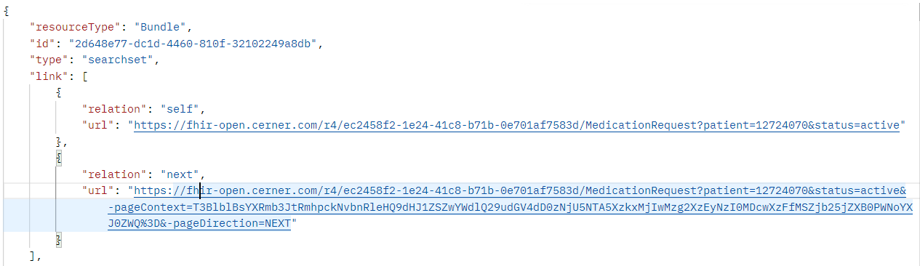
Paging
GET https://fhir-open.cerner.com/r4/ec2458f2-1e24-41c8-b71b-0e701af7583d/MedicationRequest?patient=12724070&status=active&-pageContext=T3BlblBsYXRmb3JtRmhpckNvbnRleHQ9dHJ1ZSZwYWdlQ29udGV4dD0zNjU5NTA5XzkxMjIwMzg2XzEyNzI0MDcwXzFfMSZjb25jZXB0PWNoYXJ0ZWQ%3D&-pageDirection=NEXT&_format=json
Added _format parameter

Slide 67
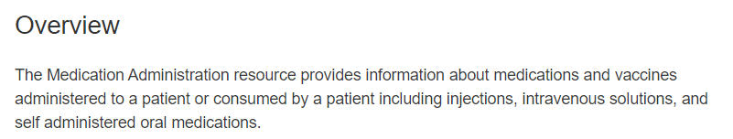
MedicationAdministration?
Could have, though question said order.
https://fhir.cerner.com/millennium/r4/clinical/medications/medication-administration/#overview

Slide 68
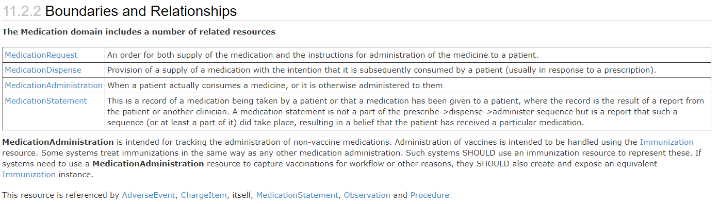
http://hl7.org/fhir/medicationadministration.html#bnr

Slide 69
Exercise 7

Slide 70
Exercise 7
What is the name of the patient with CMRN 171
Hint: the system oid is urn:oid:2.16.840.1.113883.3.787.0.0

Slide 71
Exercise 7: Answer
SMART, NANCYU
GET https://fhir-open.cerner.com/r4/ec2458f2-1e24-41c8-b71b-0e701af7583d/Patient?identifier=urn:oid:2.16.840.1.113883.3.787.0.0|171&_format=json

Slide 72
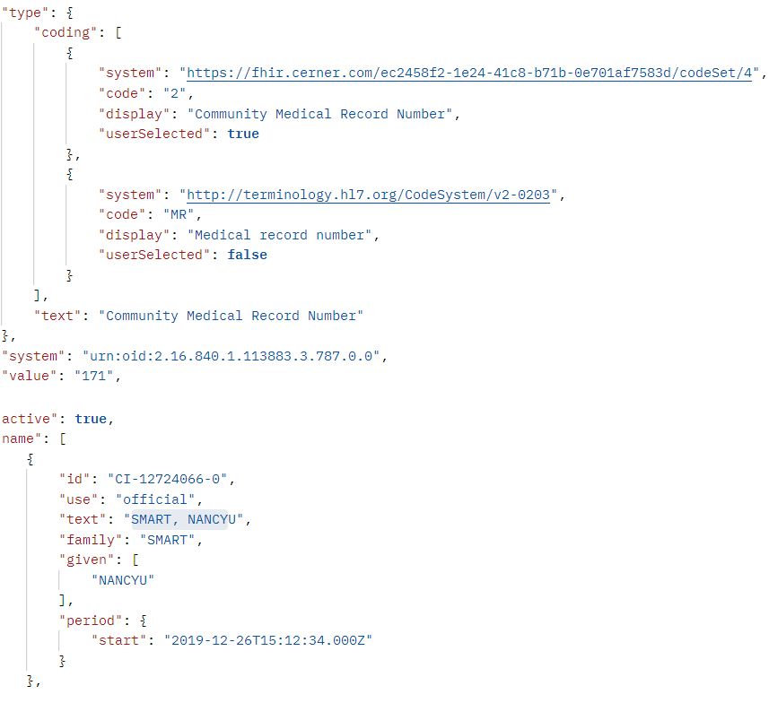

Slide 73
Extensions

Slide 74
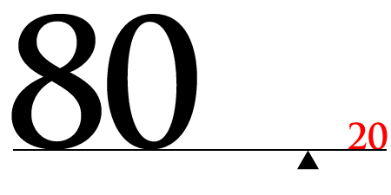
https://hl7.org/fhir/extensibility.html

Slide 75
Extension “Rules”
They’re Expected
They can nest
Server/Client cannot reject because of extension
Unless it’s a modifier

Slide 76
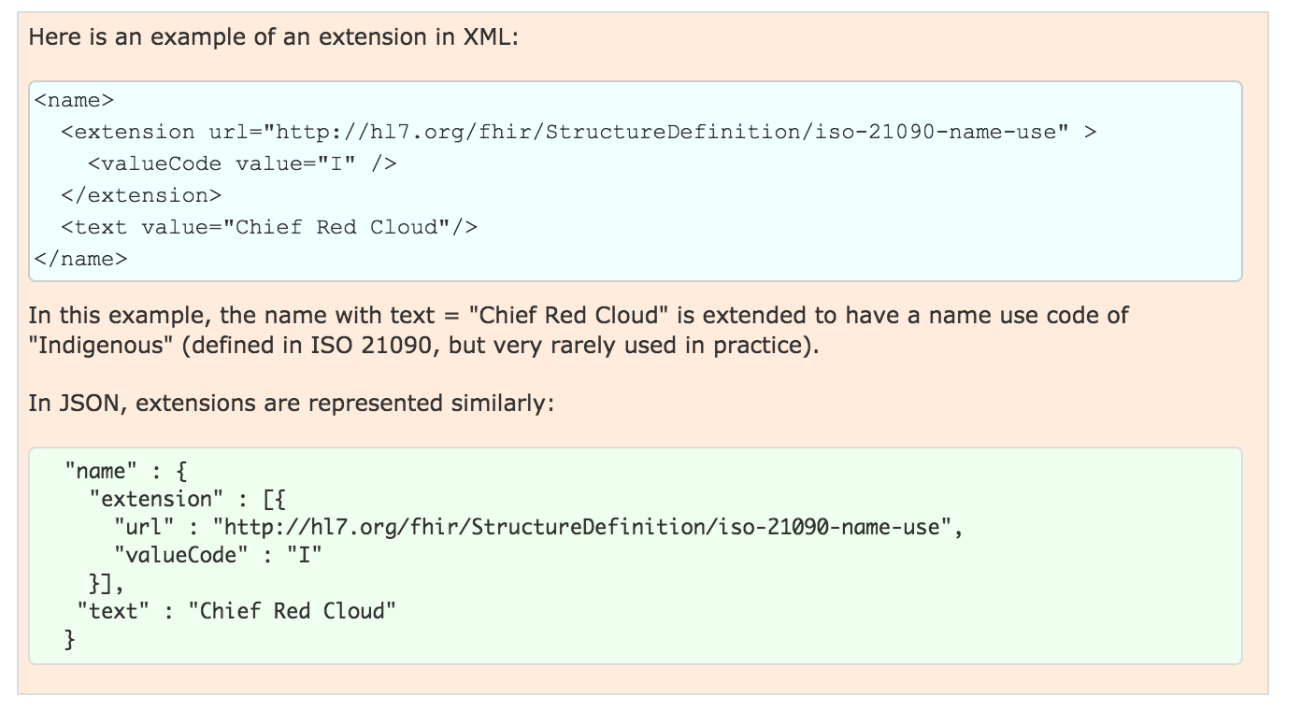
Examples

Slide 77
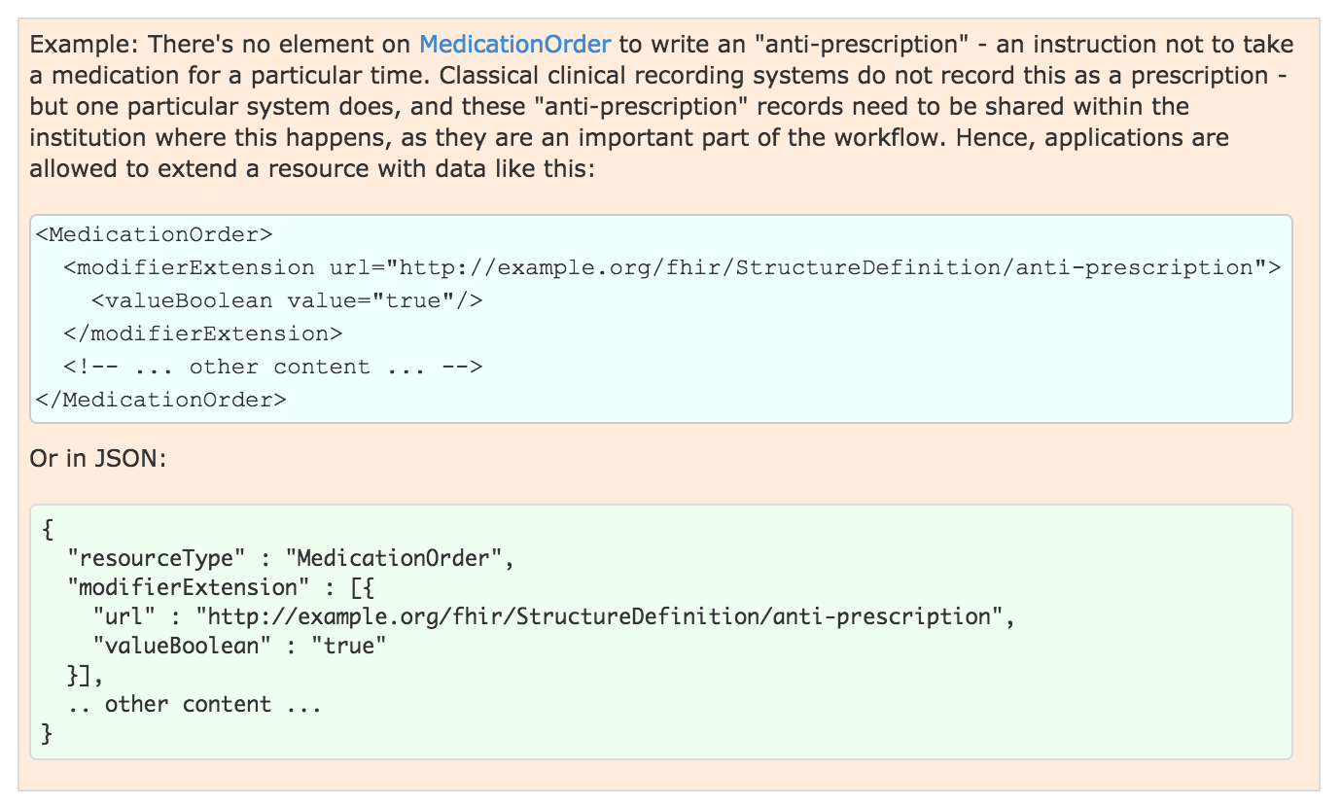
Modifier Example
Notes:
Note: this should show in the narrative

Slide 78
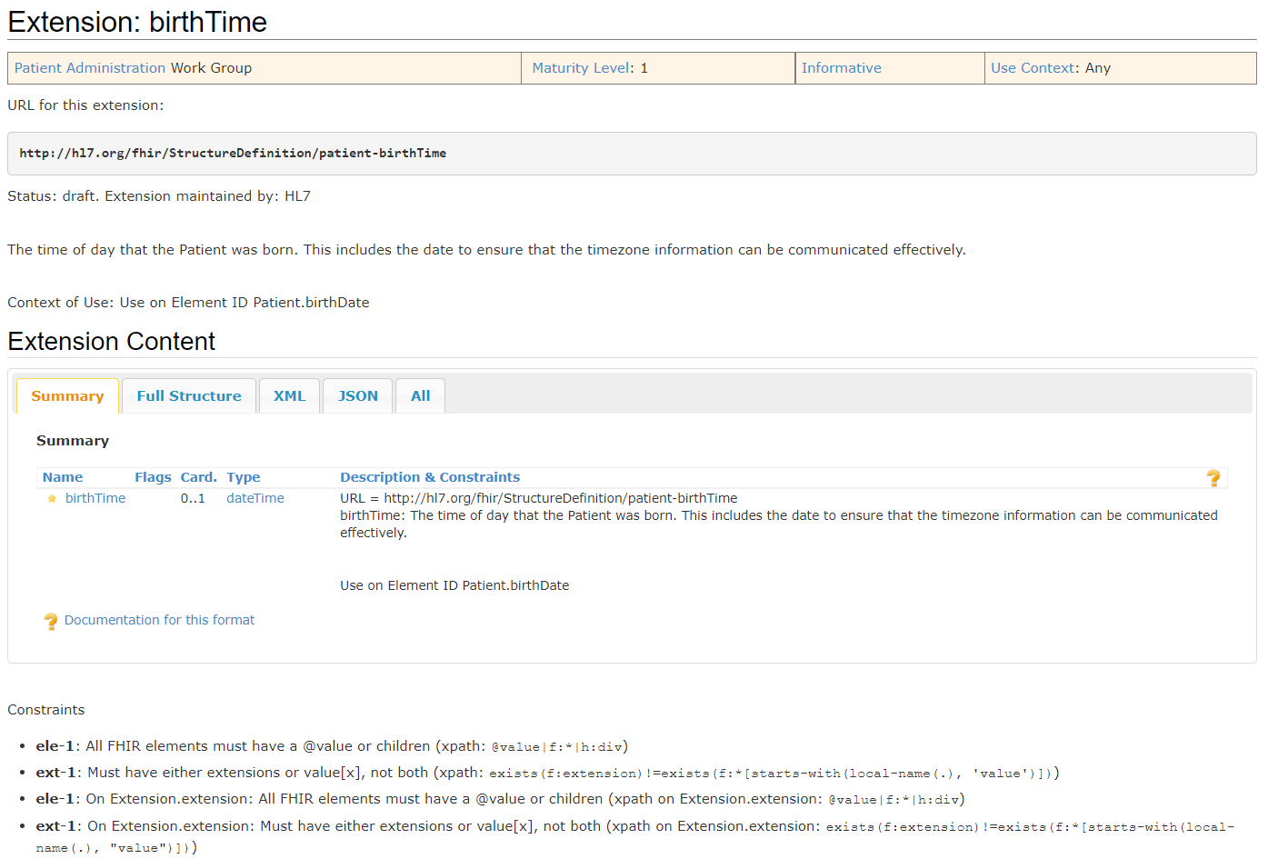
https://hl7.org/fhir/extension-patient-birthtime.html
Notes:
Not a modifier
Extension to patient.birthDate

Slide 79
Conformance

Slide 80
Conformance Resource
Weird: located at [base]/Conformance [base]/metadata
Describes the Server
Step towards auto-config
http://hl7.org/fhir/conformance-rules.html
Notes:
Can be used to describe other things, like desired implementations or capabilities, we’ll concentrate on describing a FHIR server contract.
Not enough to completely configure, but a step in that direction

Slide 81

What?
Which operations?
Which parameters?
Which formats?
Profiles…
Notes:
It defines a large part of the contract

Slide 82
Exercise 8

Slide 83
Exercise 8
Which extensions are supported by the Millennium R4 Patient resource?

Slide 84
Exercise 8: Answer
Patient Birth Time
Patient Preferred Contact
US Core Race
US Core Ethnicity
US Core Birth Sex
Communication Preference
https://fhir.cerner.com/millennium/r4/base/individuals/patient/#extensions

Slide 85
Exercise 9

Slide 86
Exercise 9
According to the Conformance statement, does this FHIR server support OAuth? https://fhir-open.cerner.com/r4/ec2458f2-1e24-41c8-b71b-0e701af7583d/
Notes:
Note: Make sure to remove spaces in your URL for FHIR - there should be none, and having spaces in the server URL will cause errors. HTTP URLs are space and case sensitive.

Slide 87
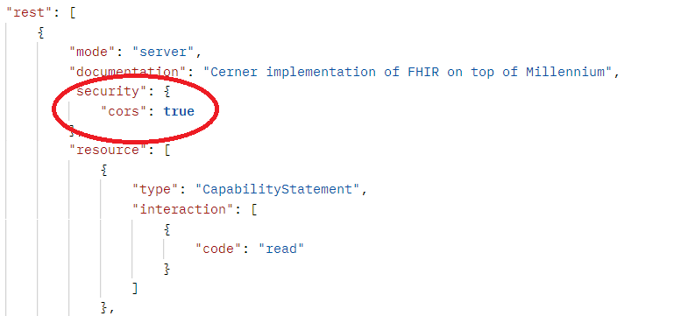
Exercise 9: Answer
Answer: No (it’s our open endpoint)
GET https://fhir-open.cerner.com/r4/ec2458f2-1e24-41c8-b71b-0e701af7583d/metadata?_format=json

Slide 88
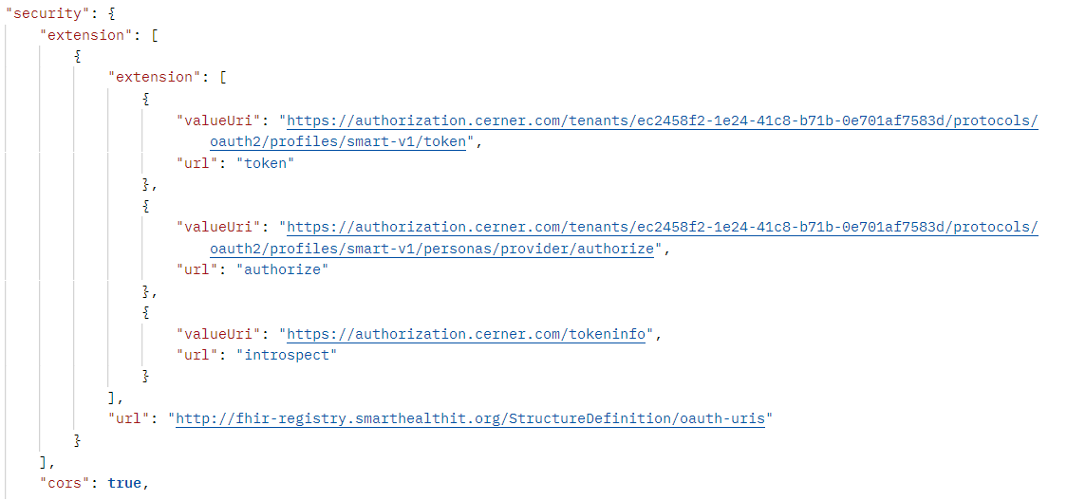
GET https://fhir-ehr.cerner.com/r4/ec2458f2-1e24-41c8-b71b-0e701af7583d/metadata?_format=json
http://hl7.org/fhir/conformance-rules.html

Slide 89
Profiles

Slide 90
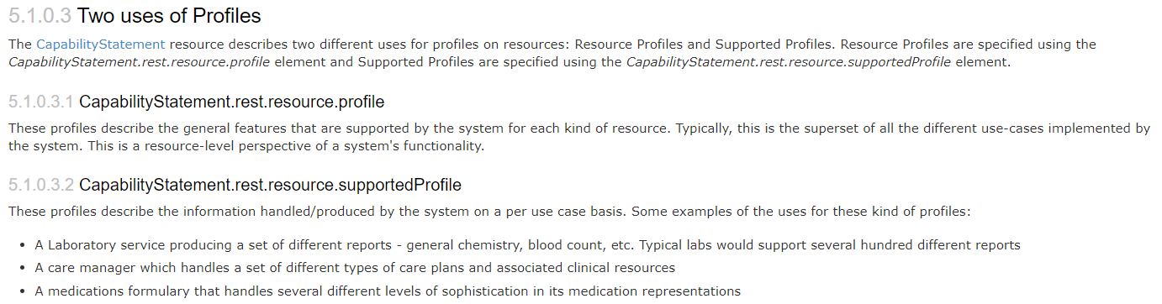
What
https://hl7.org/fhir/profiling.html
Notes:
StructureDefinition resource (in DSTU 2)
Detailed description of contracts, per user case or per system

Slide 91
Rules
Detailed contract
Parameters, operations, api calls
Fields, cardinality
Terminology binding, extensions
Must be compatible with core
Can’t change required binding
Cardinality can restrict more (1..* to 1..1 but not 0..*)
Can’t rename fields
Notes:
Compatible: If core binds as required, you can’t change it
If core has 1..*, you can’t change to 0..*, but can change to 1..1
Goal: must be safe to process a resource without the profile

Slide 92
Questions?

Slide 93
More Exercises!

Slide 94
Exercise 10

Slide 95
Exercise 10
Does Test1 Smart (id = 12724070) have a normal blood pressure?
Hint: LOINC 85354-9 can be used to find blood pressures

Slide 96
Exercise 10: Answer
It’s normal (120/80)
GET https://fhir-open.cerner.com/r4/ec2458f2-1e24-41c8-b71b-0e701af7583d/Observation?patient=12724070&code=http://loinc.org|85354-9&_format=json(code: http://loinc.org|85354-9)
Notes:
You need to ensure you properly escape/encode the URL so that protected characters are percent encoded. This is to ensure that the server can interpret the URL correctly. Postman does this for you, and *some* http libraries will, but make sure your code (or app) handles this logic to encode or decode as needed.

Slide 97
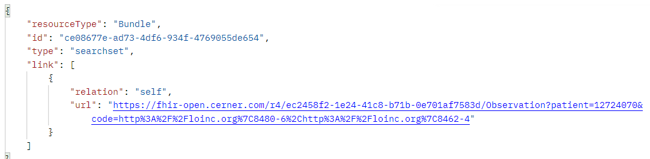
Exercise 10: Answer
Cannot use individual codes for blood pressure like we could in DSTU 2.
GET https://fhir-open.cerner.com/r4/ec2458f2-1e24-41c8-b71b-0e701af7583d/Observation?patient=12724070&code=http://loinc.org|8480-6,http://loinc.org|8462-4&_format=json
Notes:
You need to ensure you properly escape/encode the URL so that protected characters are percent encoded. This is to ensure that the server can interpret the URL correctly. Postman does this for you, and *some* http libraries will, but make sure your code (or app) handles this logic to encode or decode as needed.

Slide 98
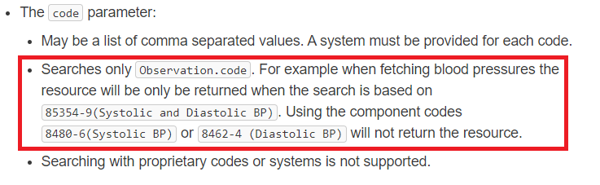
https://fhir.cerner.com/millennium/r4/clinical/diagnostics/observation/#parameters

Slide 99
Exercise 11

Slide 100
Exercise 11
Is Test1 Smart (id = 12724070) currently taking insulin?

Slide 101
Exercise 11: Answer
Answer: No
GET https://fhir-open.cerner.com/r4/ec2458f2-1e24-41c8-b71b-0e701af7583d/MedicationAdministration?patient=12724070&status=in-progress&_format=json

Slide 102
Exercise 12

Slide 103
Exercise 12
Who has a pacemaker: Sandy Smart (id= 12742399) or NancyU Smart (id = 12724066)?

Slide 104
Exercise 12: Answer
NancyU Smart
GET https://fhir-open.cerner.com/r4/ec2458f2-1e24-41c8-b71b-0e701af7583d/Device?patient=12724066&_format=json

Slide 105
Exercise 13

Slide 106
Exercise 13
Who is patient NancyU Smart’s (id = 12724066) child?

Slide 107
Exercise 13: Answer
Answer: Tim Peters, Baby Boy Smart, Sandy Smart, Timmy Smart
GET https://fhir-open.cerner.com/r4/ec2458f2-1e24-41c8-b71b-0e701af7583d/RelatedPerson?patient=12724066&-relationship-level=http://hl7.org/fhir/resource-types|Patient&_format=json

Slide 108
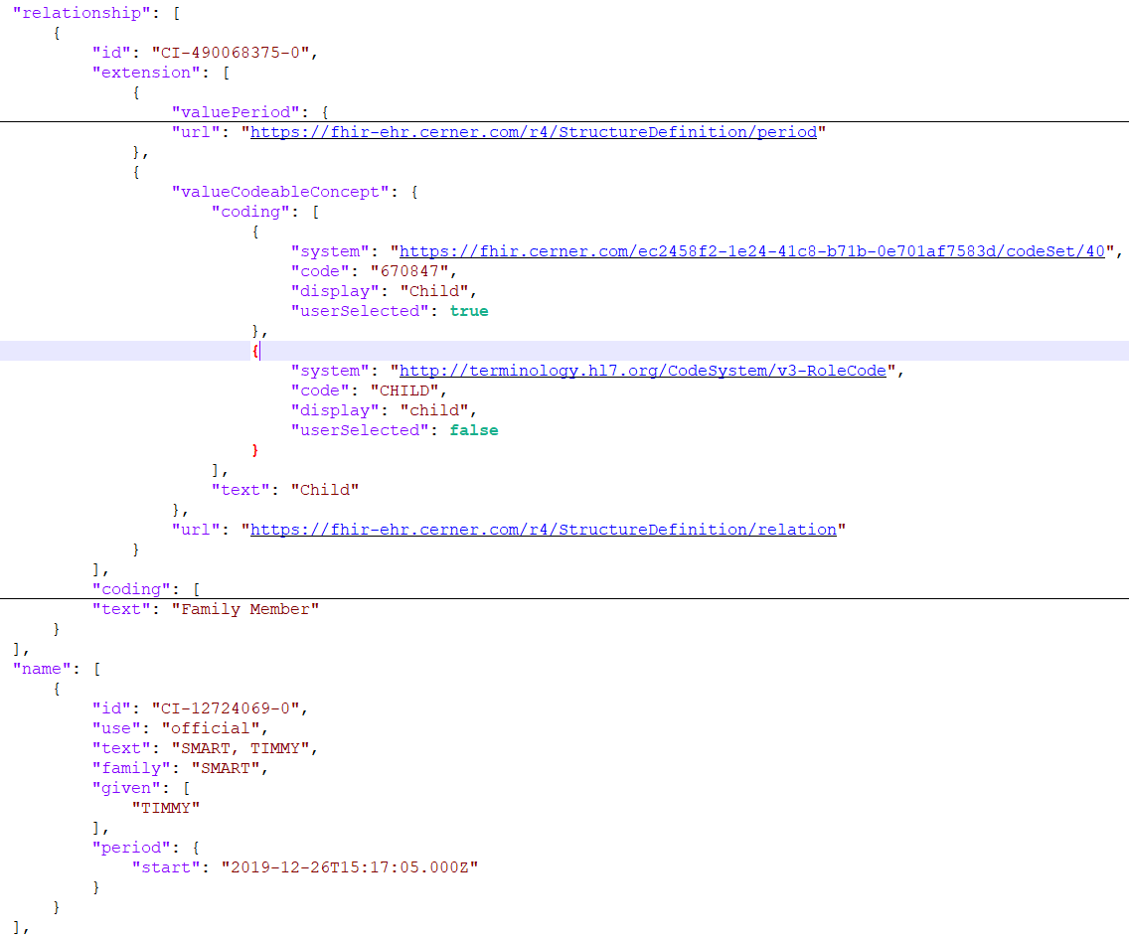

Slide 109
For more test patients
https://docs.google.com/document/d/10RnVyF1etl_17pyCyK96tyhUWRbrTyEcqpwzW-Z-Ybs

Slide 110
Questions?

